Slide 1
跟着Kevin学英语(10)
Gardening

Slide 2
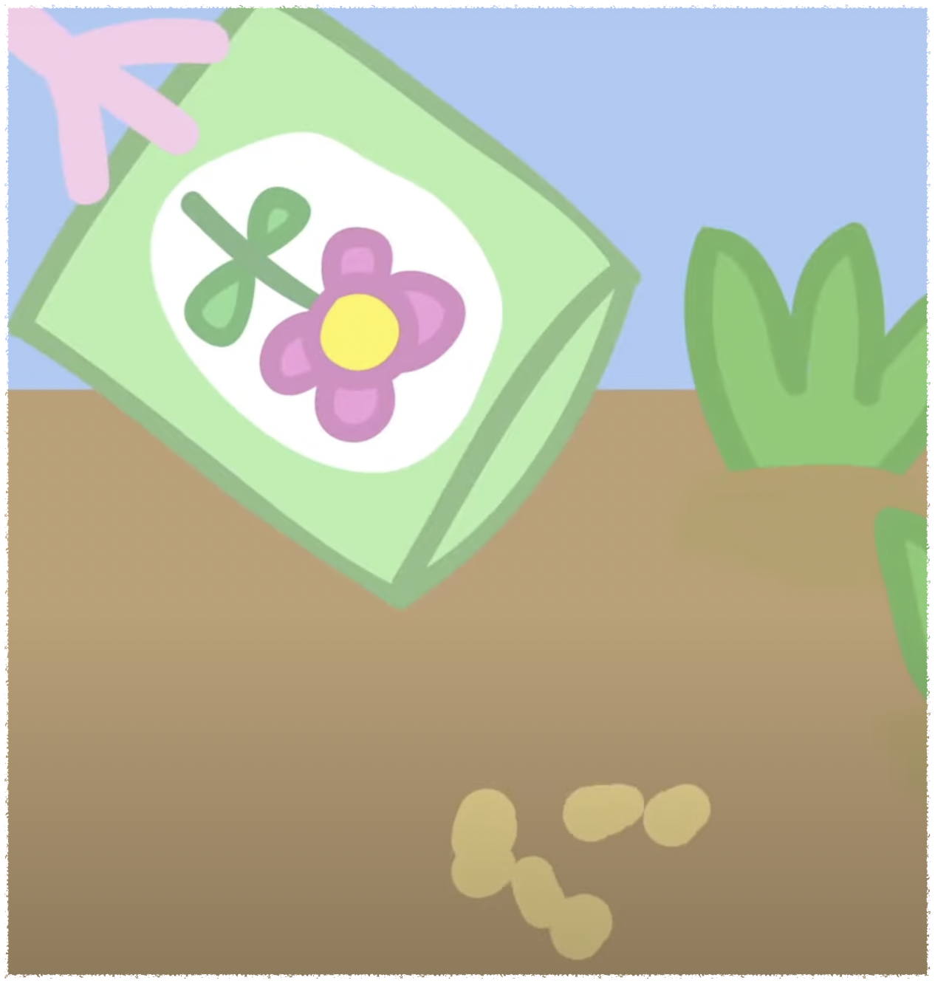
S s
Seed
Strawberry
Notes:
Put the seed in the hole

Slide 3
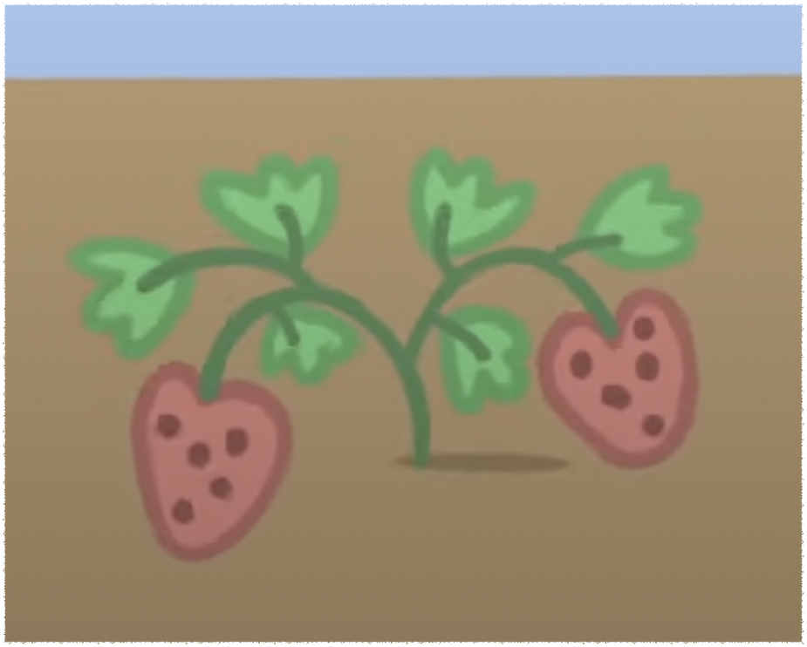
S s
Seed
Strawberry
Notes:
Would you like to plant a strawberry seed?

Slide 4

E e
Earth
Notes:
Cover it with earth

Slide 5
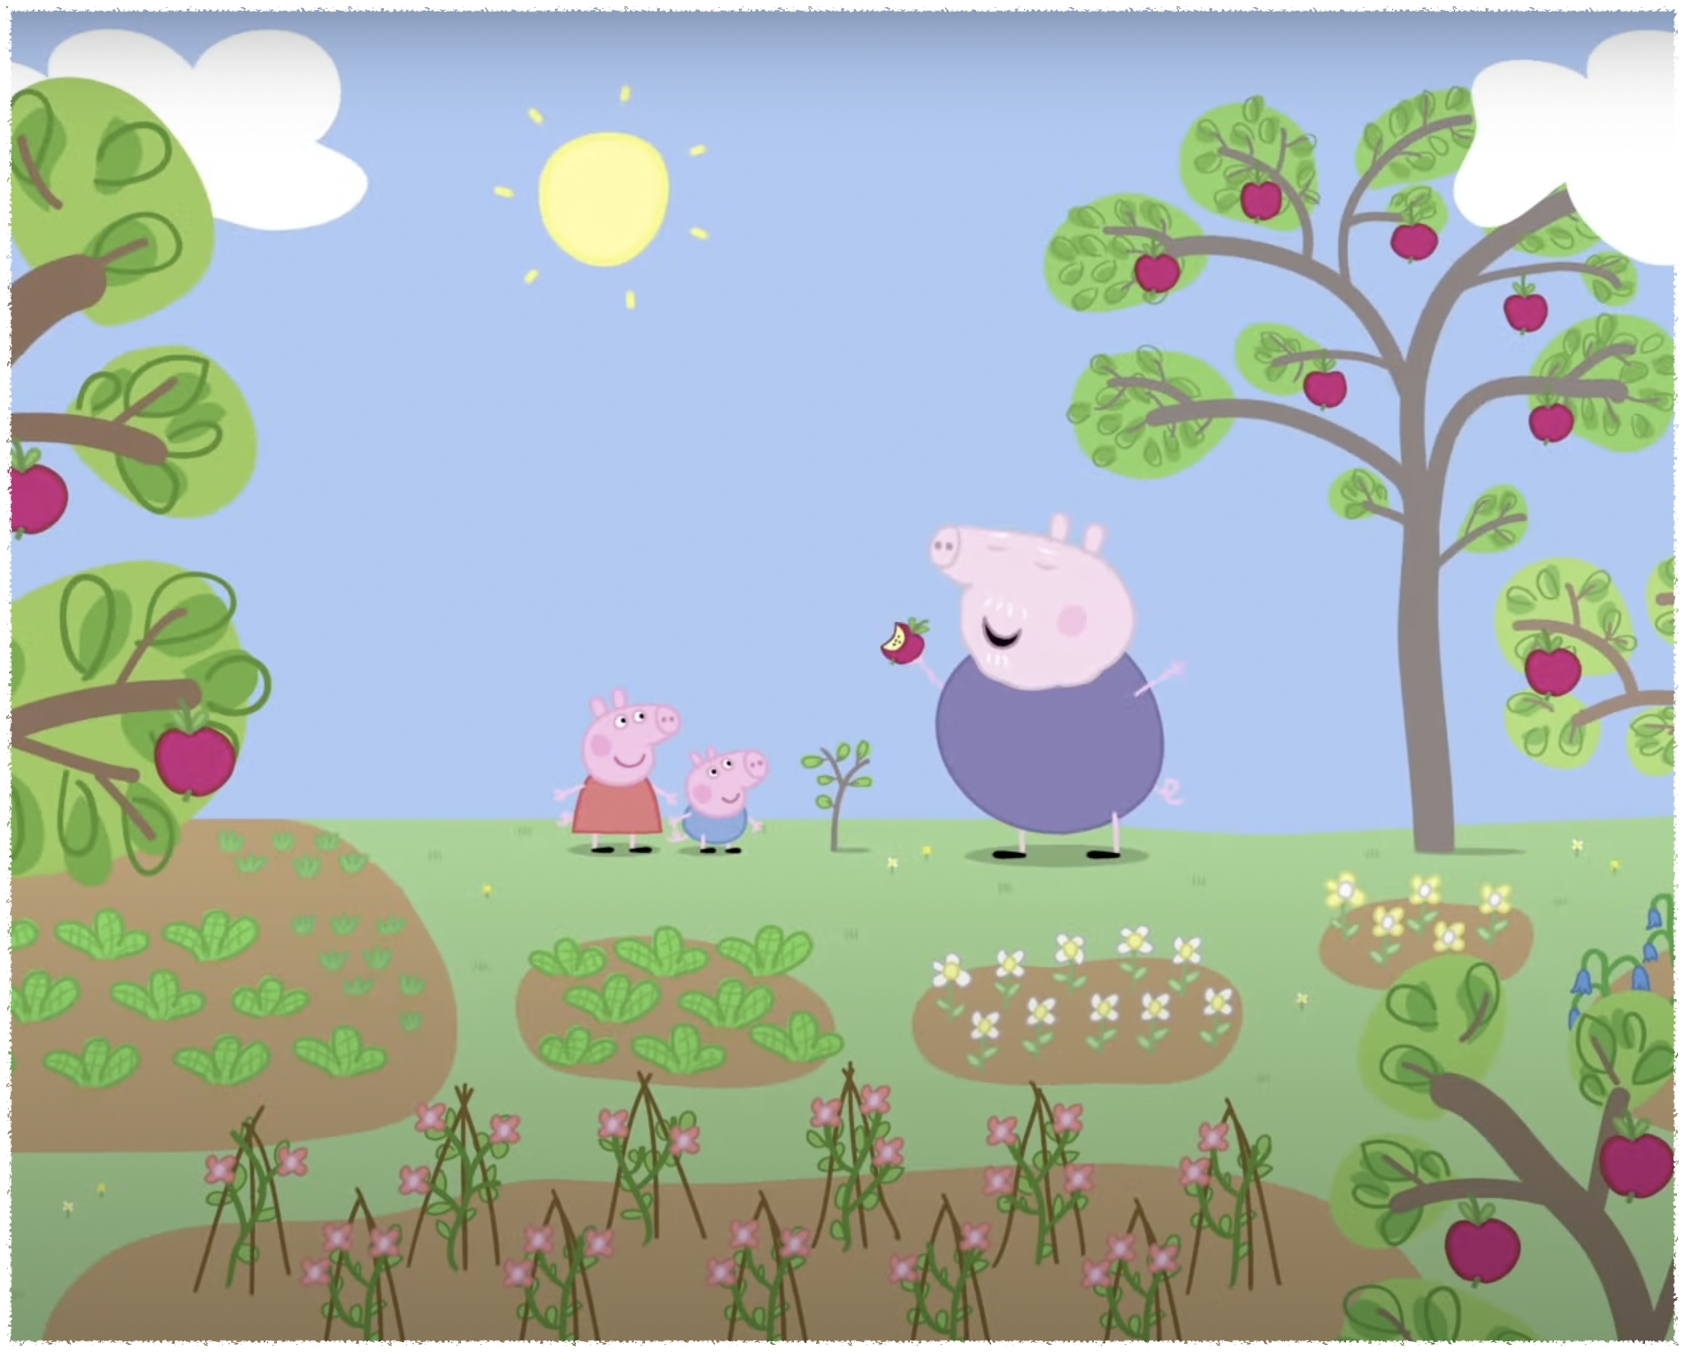
P p
Plant
Notes:
There are a lot of plants

Slide 6

H h
Hole
Notes:
I make a little hole

Slide 7
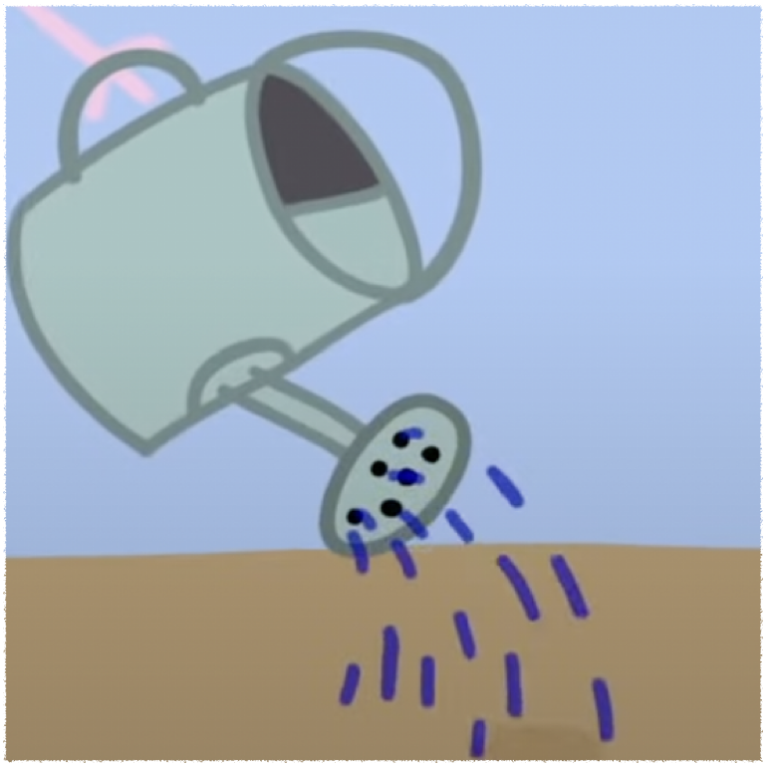
W w
Water
Wait
Notes:
I like to water the seed

Slide 8
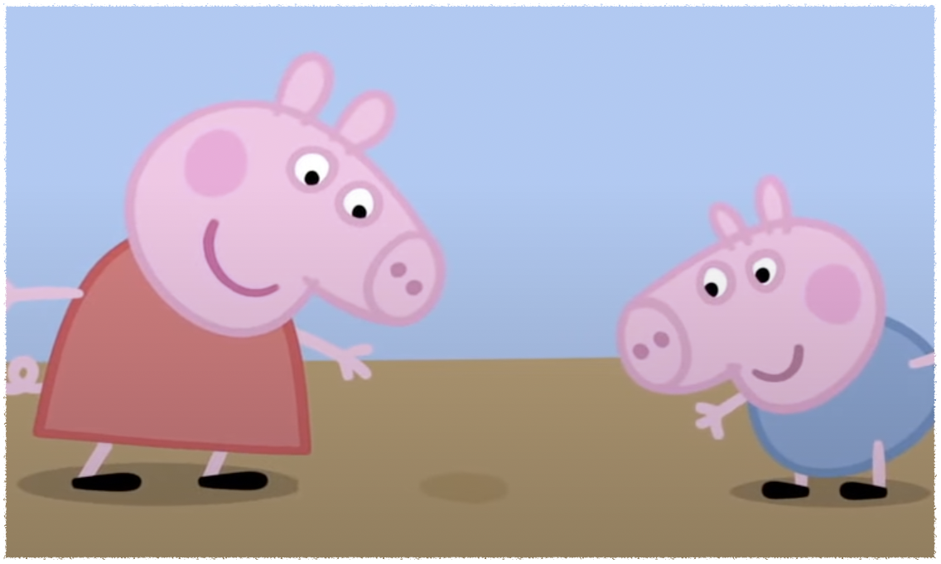
W w
Water
Wait
Notes:
We wait for it to grow

Slide 9
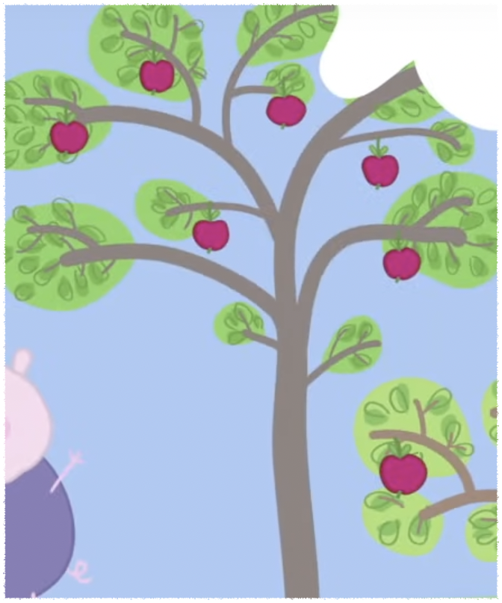
T t
tree
Notes:
This seed will grow into an apple tree

Slide 10
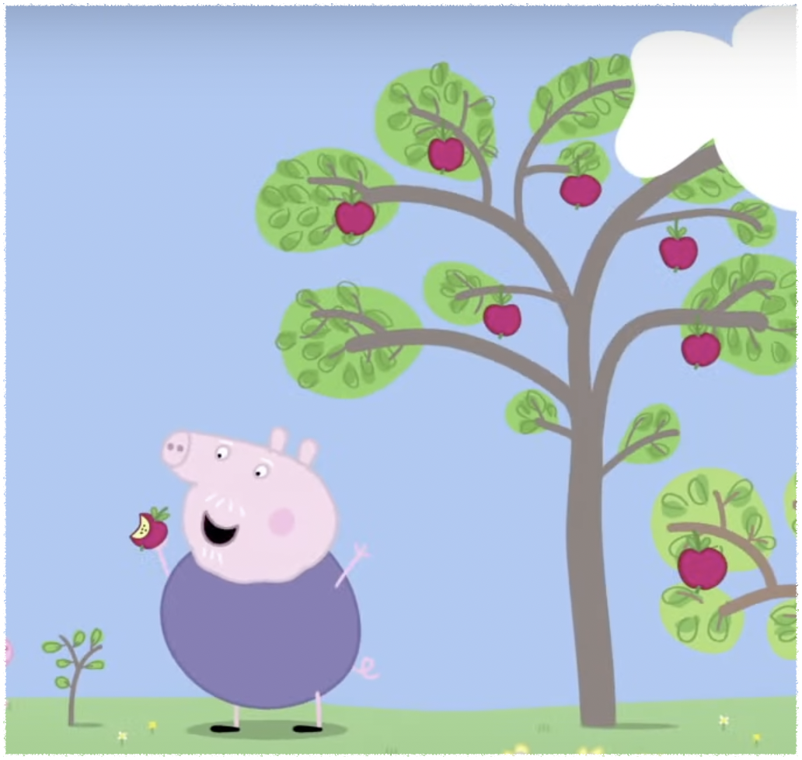
G g
Grow
Notes:
This litter apple tree will grow into a big apple tree

Slide 11
What are you doing?
It’s time to go home
We are back

